Slide 1
mckit training meeting

Slide 2
mckit structure
Universe
_cells -> list
Body
shape
material
options
Shape
Operation code (opc)
Operands (Shape or Surface)
Material
composition
density
Options (dict)
“FILL”
“MAT”
“U”
…
dict
“universe”
“transformation”

Slide 3
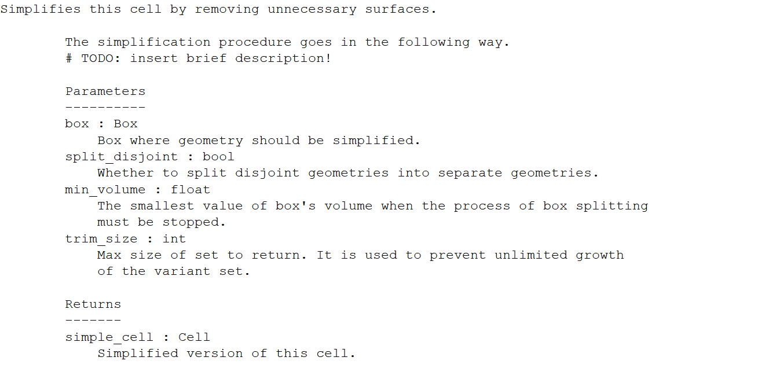
How to get help
Every public object (class, function, method) has .__doc__ field, which contains docstring
Just type: print(Body.simplify.__doc__)

Slide 4
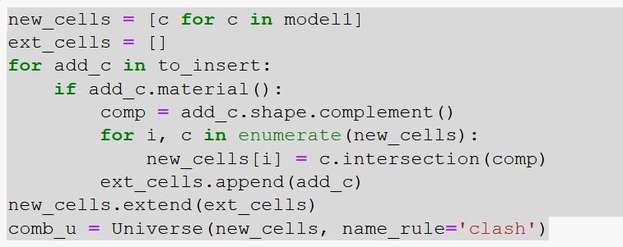
read_mcnp(filename) – reads MCNP model
mcnp_repr() – print entity as MCNP card
Universe.save(filename) – saves MCNP model

Slide 5
